Slide 1
Battle of Neighborhoods Los Angeles California
Coursera Capstone Project

Slide 2
Problem Description
Every time people want to find better place to live, they explore the place and try to get as much information as possible about it.
It can be the neighborhood, locality, market, price of the place, schools nearby and many more factors including neighborhood analysis.
In my research, I suggest create a search algorithm which usually returns the requested features such as population rate, median house price, school ratings, crime rates, weather conditions, recreational facilities etc.

Slide 3
Data Sets and technologies
For this project we need the following data:
Los Angeles data that contains list Boroughs, Neighborhoods along with their latitude and longitude
information about population, school rating, housepricing etc.
We a going to use
Foursquare API:
Unsupervised machine learning
Follium
Pandas - Library for Data Analysis
NumPy – Library to handle data
JSON – Library to handle JSON files
Geopy – To retrieve Location Data
Requests – Library to handle http requests
Matplotlib – Python Plotting Module
Sklearn – Python machine learning Library

Slide 4
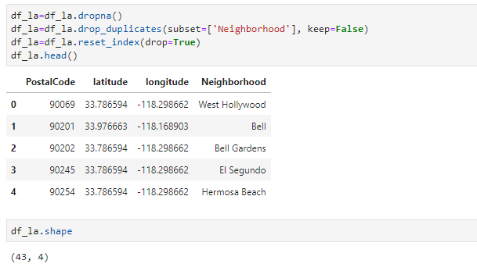
After getting and preparing data we get following dataframe:

Slide 5
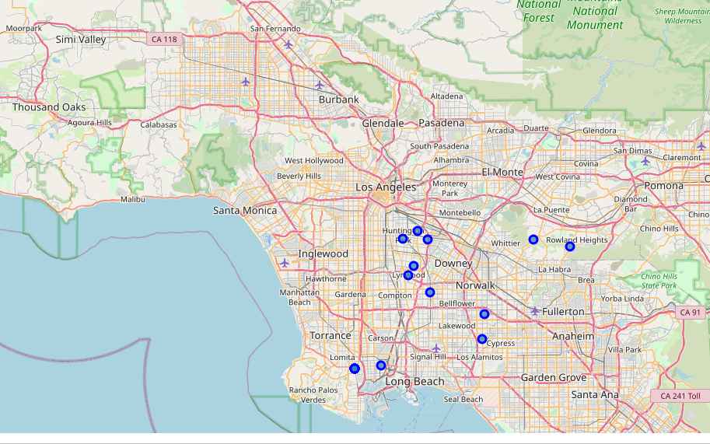
Using Follium

Slide 6
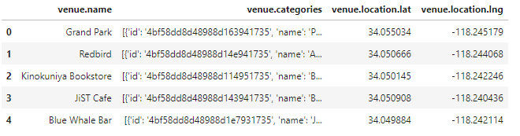
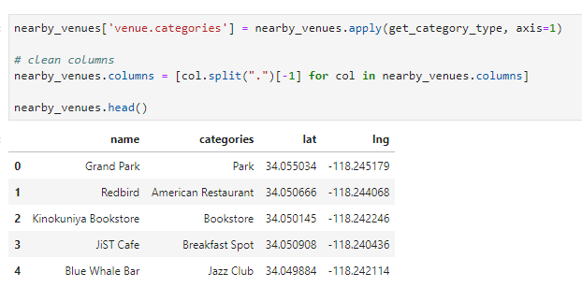
FourSquare API to collect all the popular Venues in LA Neighborhoods

Slide 7
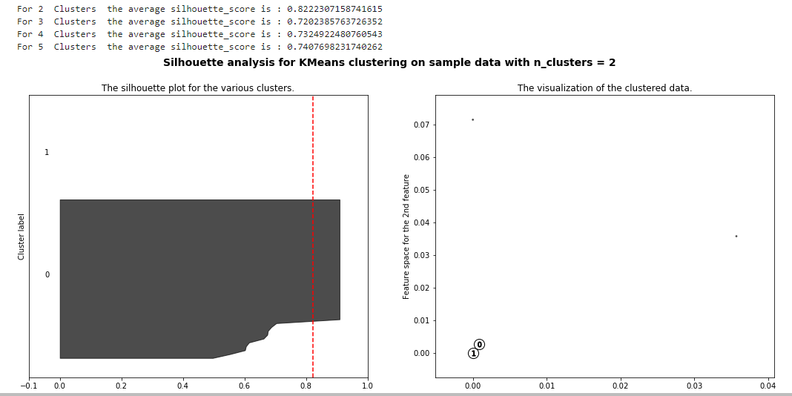
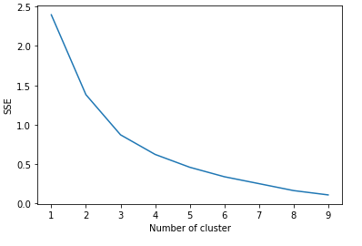
Methodology section

Slide 8
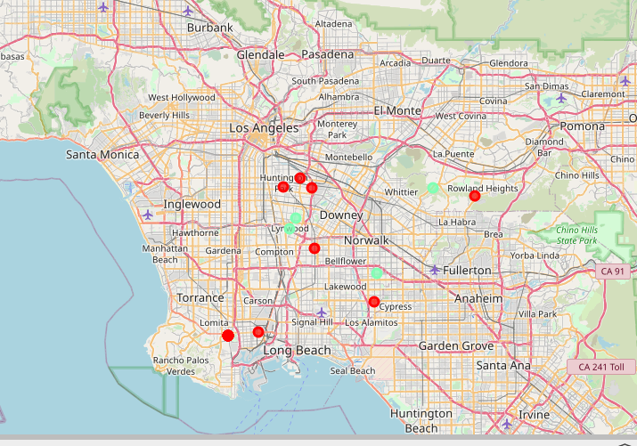
Dividing to clusters

Slide 9
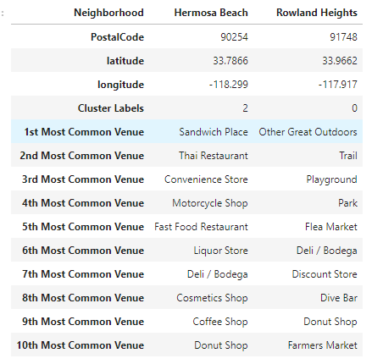
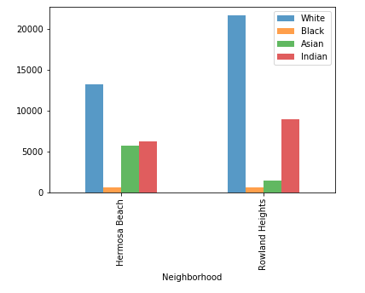
analyze 2 neighborhoods

Slide 10
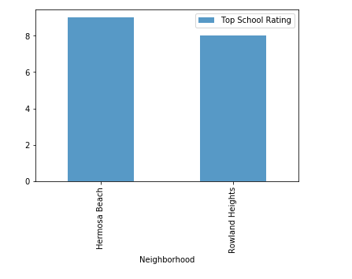
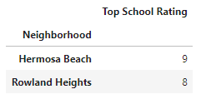
Analyze school rating

Slide 11
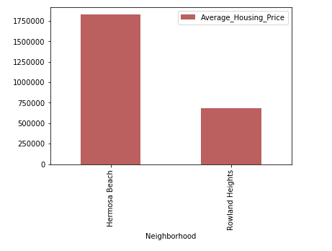
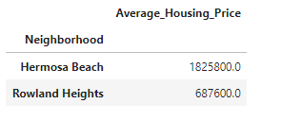
Analyze housing price

Slide 12
Conclusion an discussion
This Analysis concludes that the two places of Los Angeles Hermosa Beach and Rowland Heights.
Both has great amenities and locality, but quite different: Hermosa is seashore, Rowland Heights in and below the Puente Hills in the San Gabriel Valley, near the National Parks.
Of course the have different house pricing: out of these two Rowland Heights has better prospects for buying houses or choose for rental houses. Rowland Heights has the higher number of Indian population, but school rating is good in both areas 8+. Top 10 common venues shows Hermosa Beach has got a good neighborhood with Restaurants, Convenience Store, Cosmetic Shop, Donot Shop and many more. But housing price there is very high

Slide 13
Conclusion an discussion
For further Development I can suggest:
Get more data with different criteria for search such as:
criminal level
prices in common places
distance to other cities, national parks
unemployment level etc.
Use more machine learning for testing division to clusters.

Slide 14
Thank you!

